Slide 1
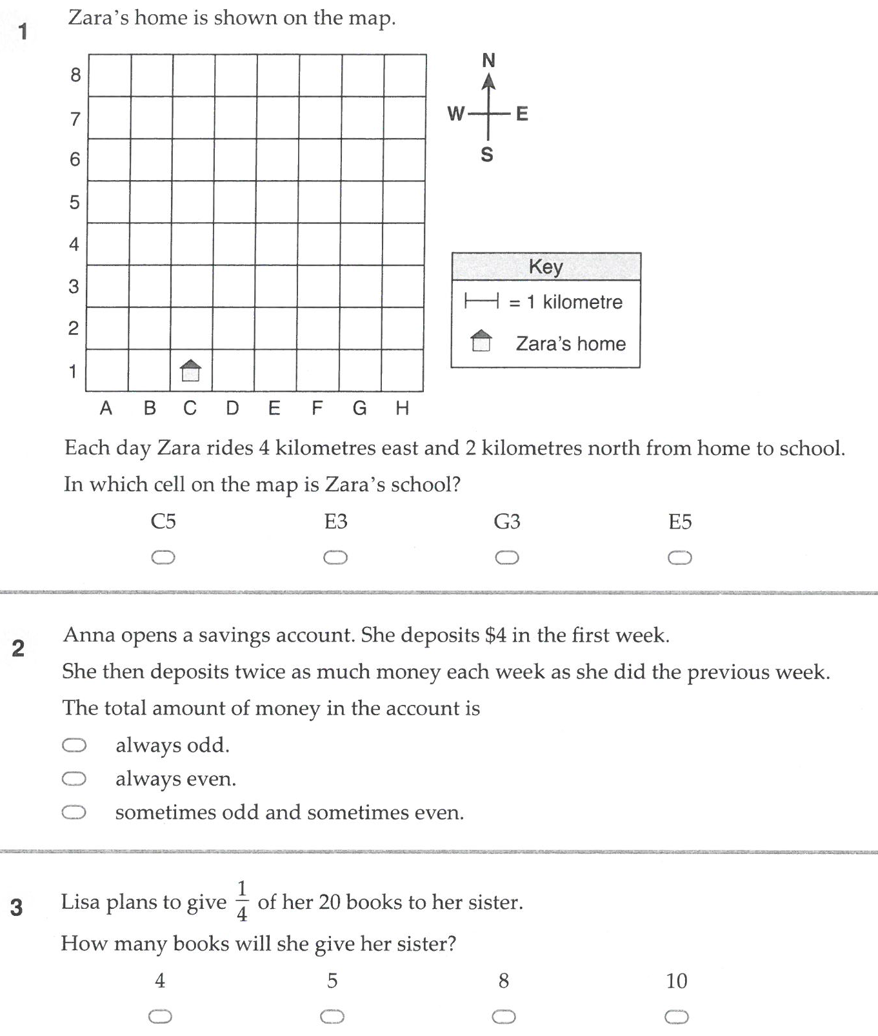
Warm Up

Slide 2
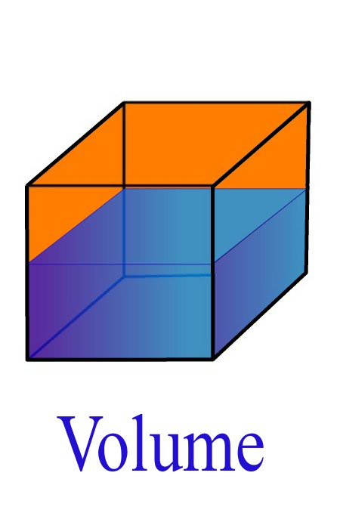
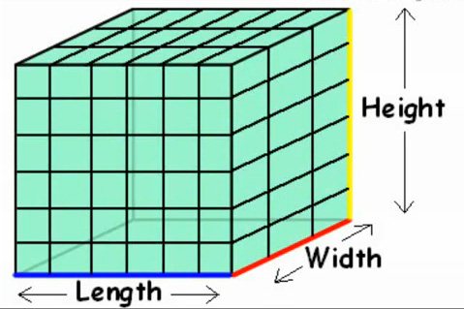
My Volume
Interactive Notebook
Name:
Class: 7 - 2
Teacher: Miss L
Term 2 Semester 1

Slide 3
Contents
Glossary or Formula Page
Page
Date
Description
2
3

Slide 4
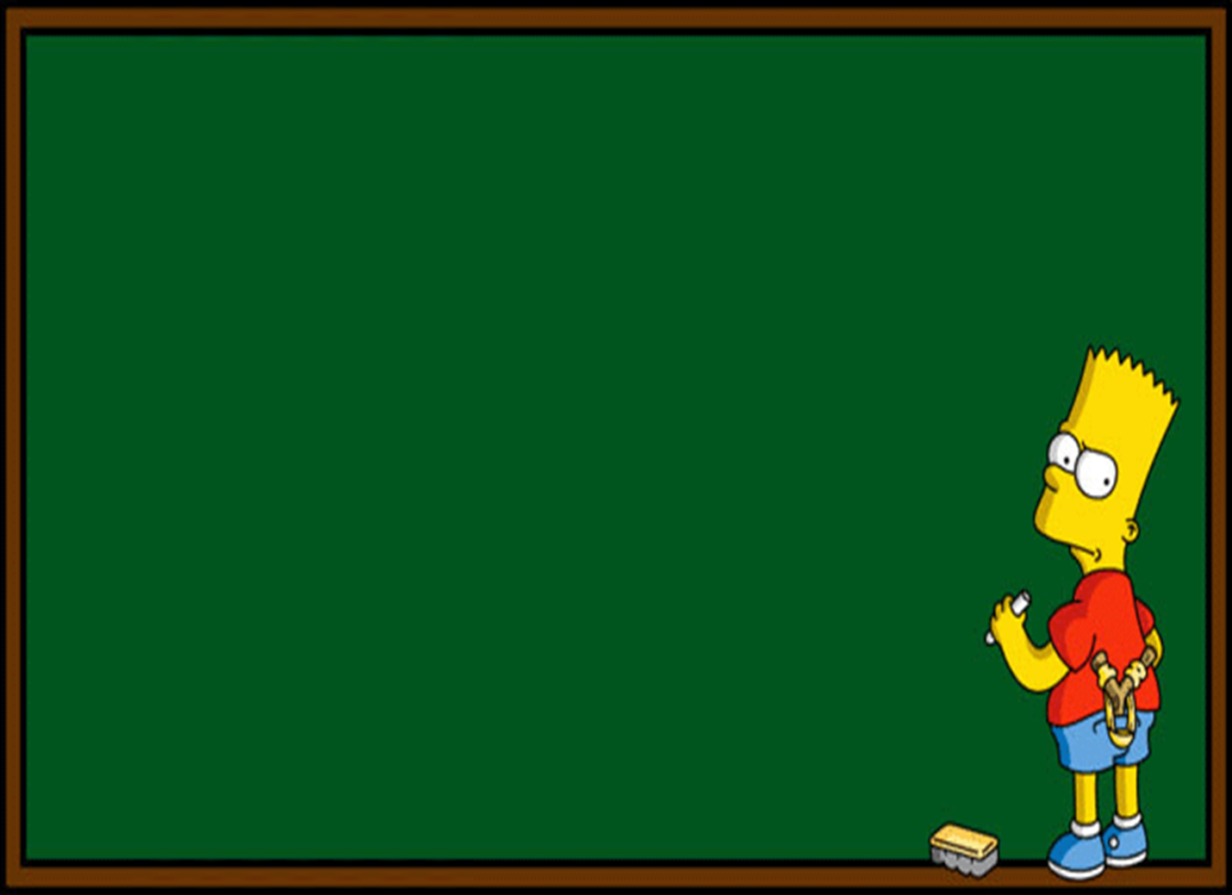
Lesson Objectives
Describe what volume is
Using the volume formula, finding the volume of rectangular prisms

Slide 5
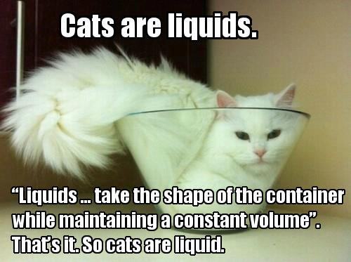
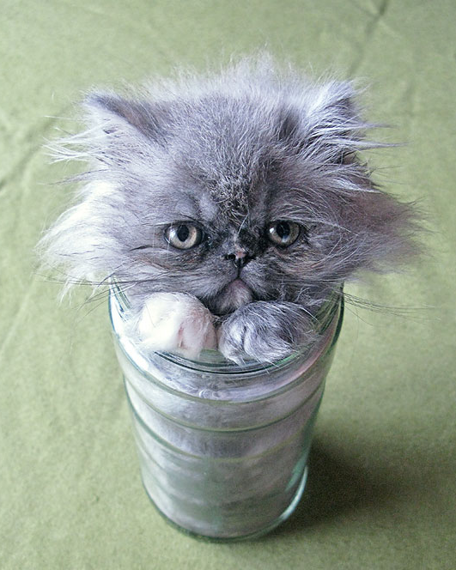
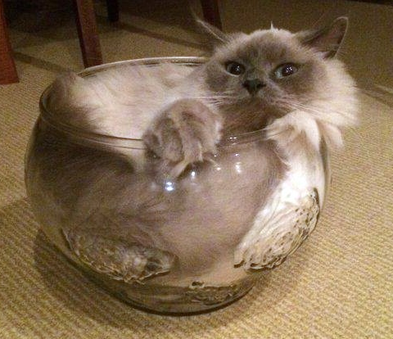
24
7
30
Topic: Volume
Date
EQ – What is volume, and how to we find it?
Volume is the amount of space occupied in three dimensions
Liquids are measured in volumes
  Like your water bottle
  Or cat……
What is volume?

Slide 6
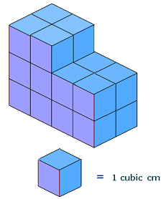
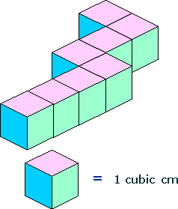
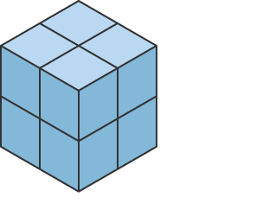
24
7
30
Topic: Volume
Date
EQ – What is volume, and how to we find it?
How would I find the volume of the following three shapes?
You add the blocks up
How to find volume?
8
20
8

Slide 7
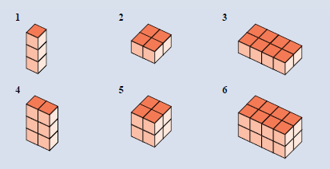
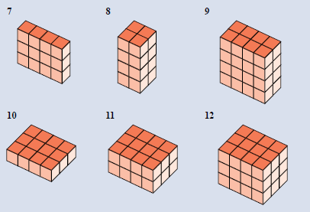
Task
Find the volume of the following blocks

Slide 8
Activity
Block Activity
Cut out the template and glue together leaving a gap at the top. Fill it in with blocks to find the volume of the shape

Slide 9
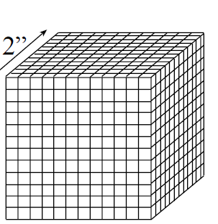
24
7
30
Topic: Volume
Date
EQ – What is volume, and how to we find it?
Is there an easier way than just adding up blocks?? Imagine adding all these blocks
How to find volume?

Slide 10
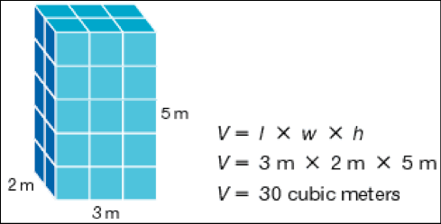
24
7
30
Topic: Volume
Date
EQ – What is volume, and how to we find it?
How to find volume?
Volume = Length x Width x Height

Slide 11
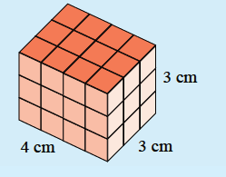
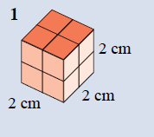
Examples
Volume = Length x Width x Height

Slide 12
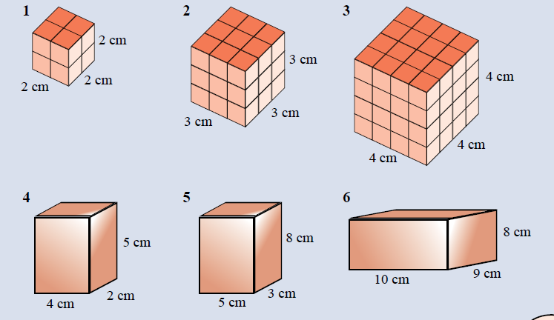
Task

